Slide 1



Assignment 1: Google Trends and Stock price fluctuations
Anesu Mukuvari 2020135568, Ayanda Mhlauli 2021442765
Group 4
Honours in Business and Financial Analytics EDAB6800
ASSESSOR: Dr Herkulaas MvE Combrink, Dr Nyashadzashe Tamuka, V Oelofse
1 of 16

Slide 2
Introduction and Background
Investor behaviour has shifted to online information-seeking, especially retail investors (Barber & Odean, 2008).
Google Trends provides real-time proxy for public interest (Da, Engelberg & Gao, 2011).
Spikes in search activity often precede trading volume and price movements (Bui & Nguyen, 2019).
Study investigates whether Google Search Volume Index (GSVI) can predict FirstRand stock movements on JSE.
2 of 16
Notes:
Good day, everyone. Our research investigates whether online search trends, specifically Google Search Volume Index, can predict the movements of FirstRand’s stock price on the JSE. We focus on how retail investor behaviour has shifted toward online information, using Google Trends as a real-time proxy for public interest. Literature shows that surges in search activity often precede trading volume and price moves, which forms the foundation for our study

Slide 3
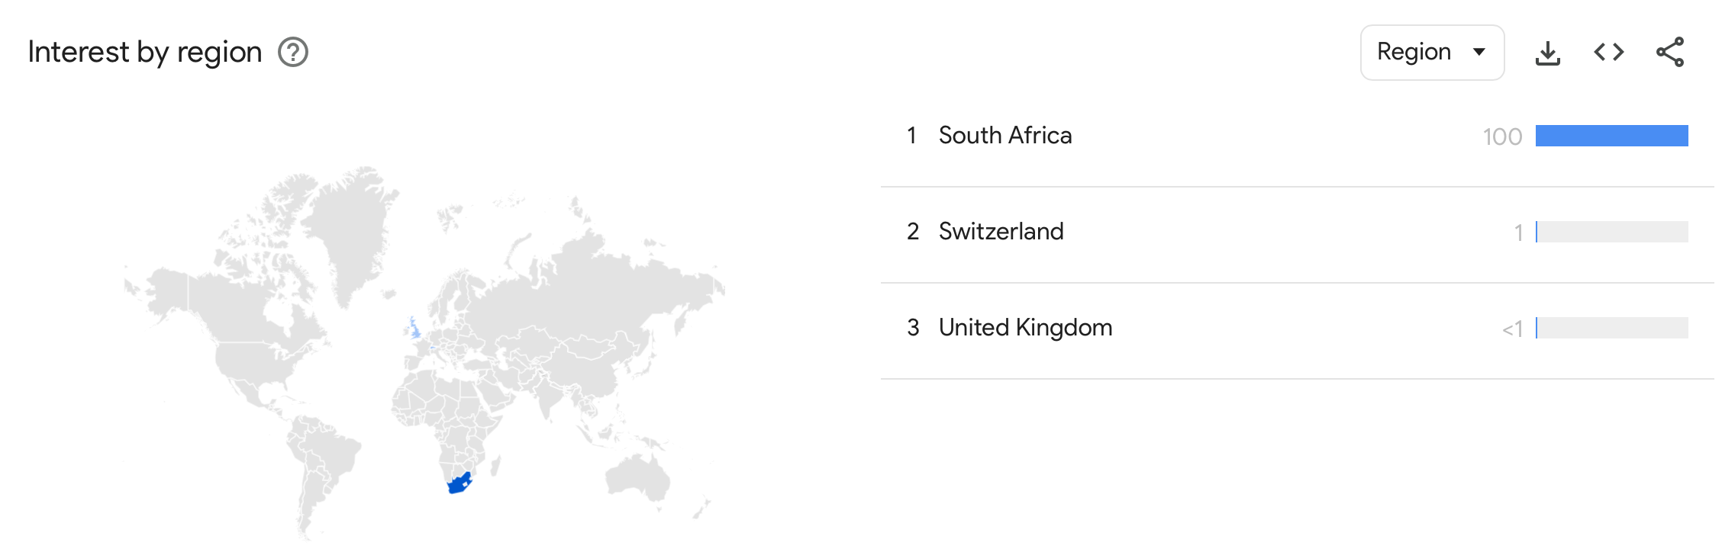
Is This Possible
(Evidence From literature)
Takeda and Wakao (2014) – GSVI effects stronger in retail-heavy Japanese stocks.
Bui and Nguyen (2019) – Abnormal searches precede trading volume surges (Vietnam).
Da, Engelberg and Gao (2011) – Google search volume predicts US equity returns.
Ayala et al (2020) – GSVI positively related to volatility and trading volume (the review used 56 studies).
Joseph, Babajide and Chen (2011) – Search spikes drive short-term price pressures.
3 of 17
Notes:
Numerous academic studies support this approach. For example, Takeda and Wakao found stronger effects in retail-heavy Japanese stocks, while Bui and Nguyen showed abnormal searches precede surges in trading volume in Vietnam. Da, Engelberg, and Gao linked Google search volumes to US equity returns. A broad review of 56 studies finds a positive relationship between search volume and market outcomes, suggesting these online patterns can offer meaningful signals to investors.

Slide 4
Why firstrand?
Market Significance – One of South Africa’s largest financial institutions.
Retail Investor Visibility – Large retail customer base via FNB.
Consistent with Literature – Attention-driven trading strong in retail-heavy stocks.
Information-Seeking Proxy – Financial firms frequently used to test investor behavior.
Market Share – Has the Largest publicly owned stake.
4 of 16
Notes:
We chose FirstRand for its market prominence, representing one of South Africa’s largest institutions with a big retail client base, mostly through FNB. Its size and visibility make it an ideal proxy for information-driven trading behaviour on the JSE, aligning closely with attention-driven trading literature. With the largest publicly owned stake, FirstRand provides robust data for testing predictive relationships.

Slide 5
Methodology
(Time Series Analysis)
Stationarity Testing :
- We Applied Augmented Dickey-Fuller (ADF) tests to confirm stationarity.
- Differenced non-stationary series to achieve stationarity.
Transformations :
- Daily log returns calculated for stock prices.
Justification: Stationarity prevents spurious regressions; daily aggregation effective (Gujarati, 2003; Da et al., 2011)
5 of 16
Notes:
Moving to our approach, we started by ensuring the data’s validity through stationarity testing using Augmented Dickey-Fuller tests. Stationarity was essential to prevent spurious results, so we transformed non-stationary series using differencing and calculated daily log returns for accuracy. These data preparation steps are common in behavioural finance, following Gujarati and Da et al.

Slide 6
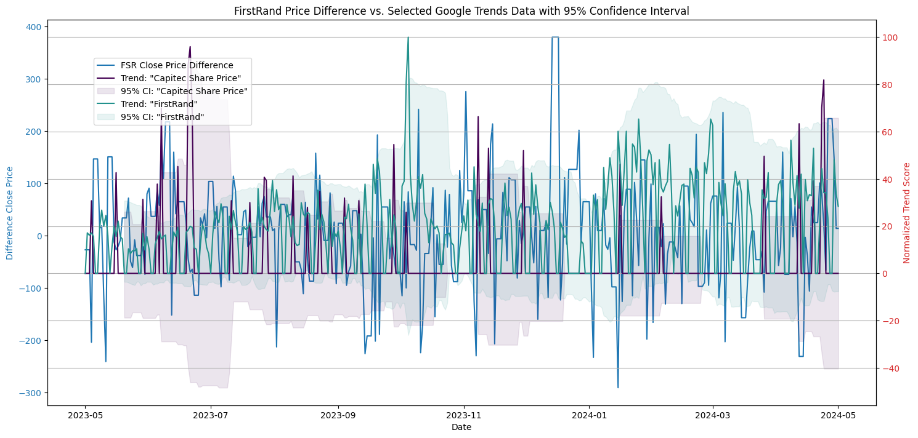
Results and Insights
ADF tests confirmed non-stationarity in levels of keywords and stock price.
Stationarity achieved for both variables after first differencing.
Weekly Google search activity for “FirstRand” and “FNB” showed spikes around major market events (such as interest rate announcements, earnings releases).
Suggests investor attention rises during periods of heightened financial news or volatility.
6 of 16
Notes:
Our results showed initial non-stationarity in both keyword searches and stock prices, but stationarity was achieved after differencing. Weekly Google searches for FirstRand and FNB consistently spiked around major news events, such as earnings releases or interest rate announcements, indicating that investor attention rises sharply during periods of heightened market activity or volatility.

Slide 7
Methodology
(Statistical Approach)
Regression Analysis
Granger Causality Test
The equation tested if the GSVI has an impact on stock closing prices.
Tried to identify predictive links between the GSVI and the movement of the stock closing prices.
Examined lead–lag dynamics between GSVI and stock performance.
Key question: Does investor attention predict stock changes, or react to them?
  Justification: These approaches have been commonly used in behavioural finance literature (Da et al., 2011; Bui & Nguyen, 2019).
7 of 16
Notes:
Our analysis found a positive but statistically weak relationship between search activity and weekly returns. Essentially, investors tend to search more when trading activity increases, rather than before. The Granger causality test did not find strong evidence that GSVI causes price changes or vice versa, suggesting investor attention typically trails behind market moves in this context.

Slide 8
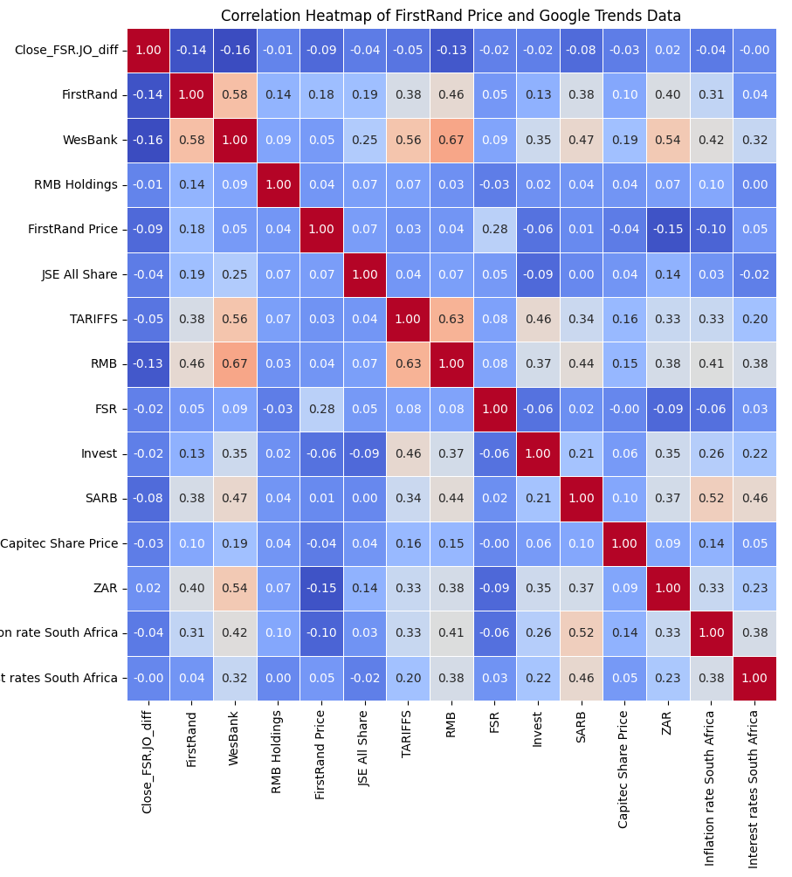
Regression Findings
Positive but statistically weak relationship between Google search activity and weekly returns.
Interpretation: investors tend to search more when trading activity increases, not necessarily before returns change.
8 of 16
Notes:
Our analysis found a positive but statistically weak relationship between search activity and weekly returns. Essentially, investors tend to search more when trading activity increases, rather than before. The Granger causality test did not find strong evidence that GSVI causes price changes or vice versa, suggesting investor attention typically trails behind market moves in this context.

Slide 9
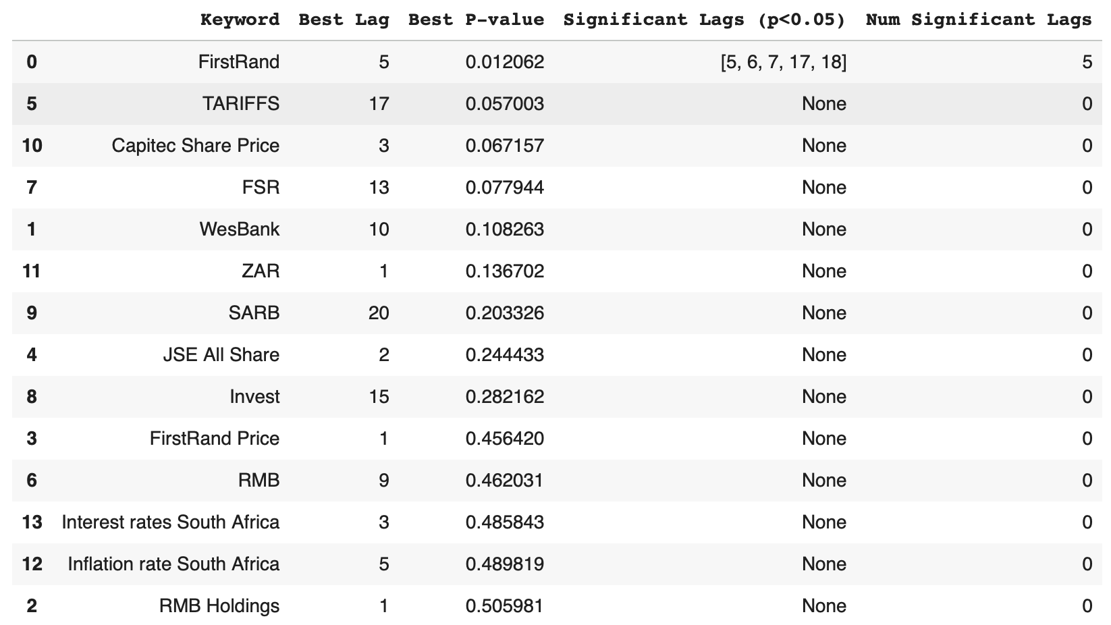
Granger Causality Findings
No strong evidence that
GSVI Granger-causes returns.
Little evidence that returns
Granger-cause search volume.
Implications: Attention tends to lag behind price activity; consistent with emerging market findings
9 of 16
Notes:
Our analysis found a positive but statistically weak relationship between search activity and weekly returns. Essentially, investors tend to search more when trading activity increases, rather than before. The Granger causality test did not find strong evidence that GSVI causes price changes or vice versa, suggesting investor attention typically trails behind market moves in this context.

Slide 10
Methodology
(Machine learning approach)
MODEL | HOW IT WORKS | STRENGTHS | WEAKNESSES
KNN | Pattern matching using nearest neighbours | Simple, non-parametric | Sensitive to noise
RANDOM FOREST | Ensemble of decision trees | Handles non-linearity well | Can overfit on small data
GRADIENT BOOSTING | Sequential tree building | High accuracy potential | Computationally intensive
XGBOOST | Optimized gradient boosting | Fast, efficient, robust | Requires parameter tuning
10 of 16
Notes:
To strengthen our analysis, we applied machine learning models: KNN, Random Forest, Gradient Boosting, and XGBoost. These cover a spectrum from pattern-matching to sophisticated ensemble techniques. XGBoost, for example, blends speed, accuracy, and efficiency, making it well-suited for financial forecasting, while Random Forest can handle complex non-linearity but risks overfitting on small datasets.

Slide 11
Methodology
(REGRESSION PERFOMANCE METRICS)
Model | Train RMSE | Test RMSE | Train MAE | Test MAE | Test MAPE (%) | Train R² | Test R²
KNN | 0.0000 | 100.8229 | 0.0000 | 75.4716 | 118.5576 | 1.0000 | -0.0770
Random Forest | 86.1928 | 96.4263 | 65.0821 | 73.2154 | 109.5739 | 0.2639 | 0.0149
XGBoost | 73.4267 | 94.5012 | 56.7928 | 73.7905 | 135.6214 | 0.4658 | 0.0538
Gradient Boosting | 76.5292 | 97.4054 | 58.6658 | 76.3615 | 131.9190 | 0.4197 | -0.0052
11 of 16
Notes:
In testing, XGBoost was our top performer, with accuracy improving from 57% to over 71% after optimizing lag features. We compared models using RMSE, MAE, and R metrics to gauge their predictive power and error rates. Classification accuracy rose with feature engineering, but some error persisted due to low search volumes and the short timeframe available for analysis

Slide 12
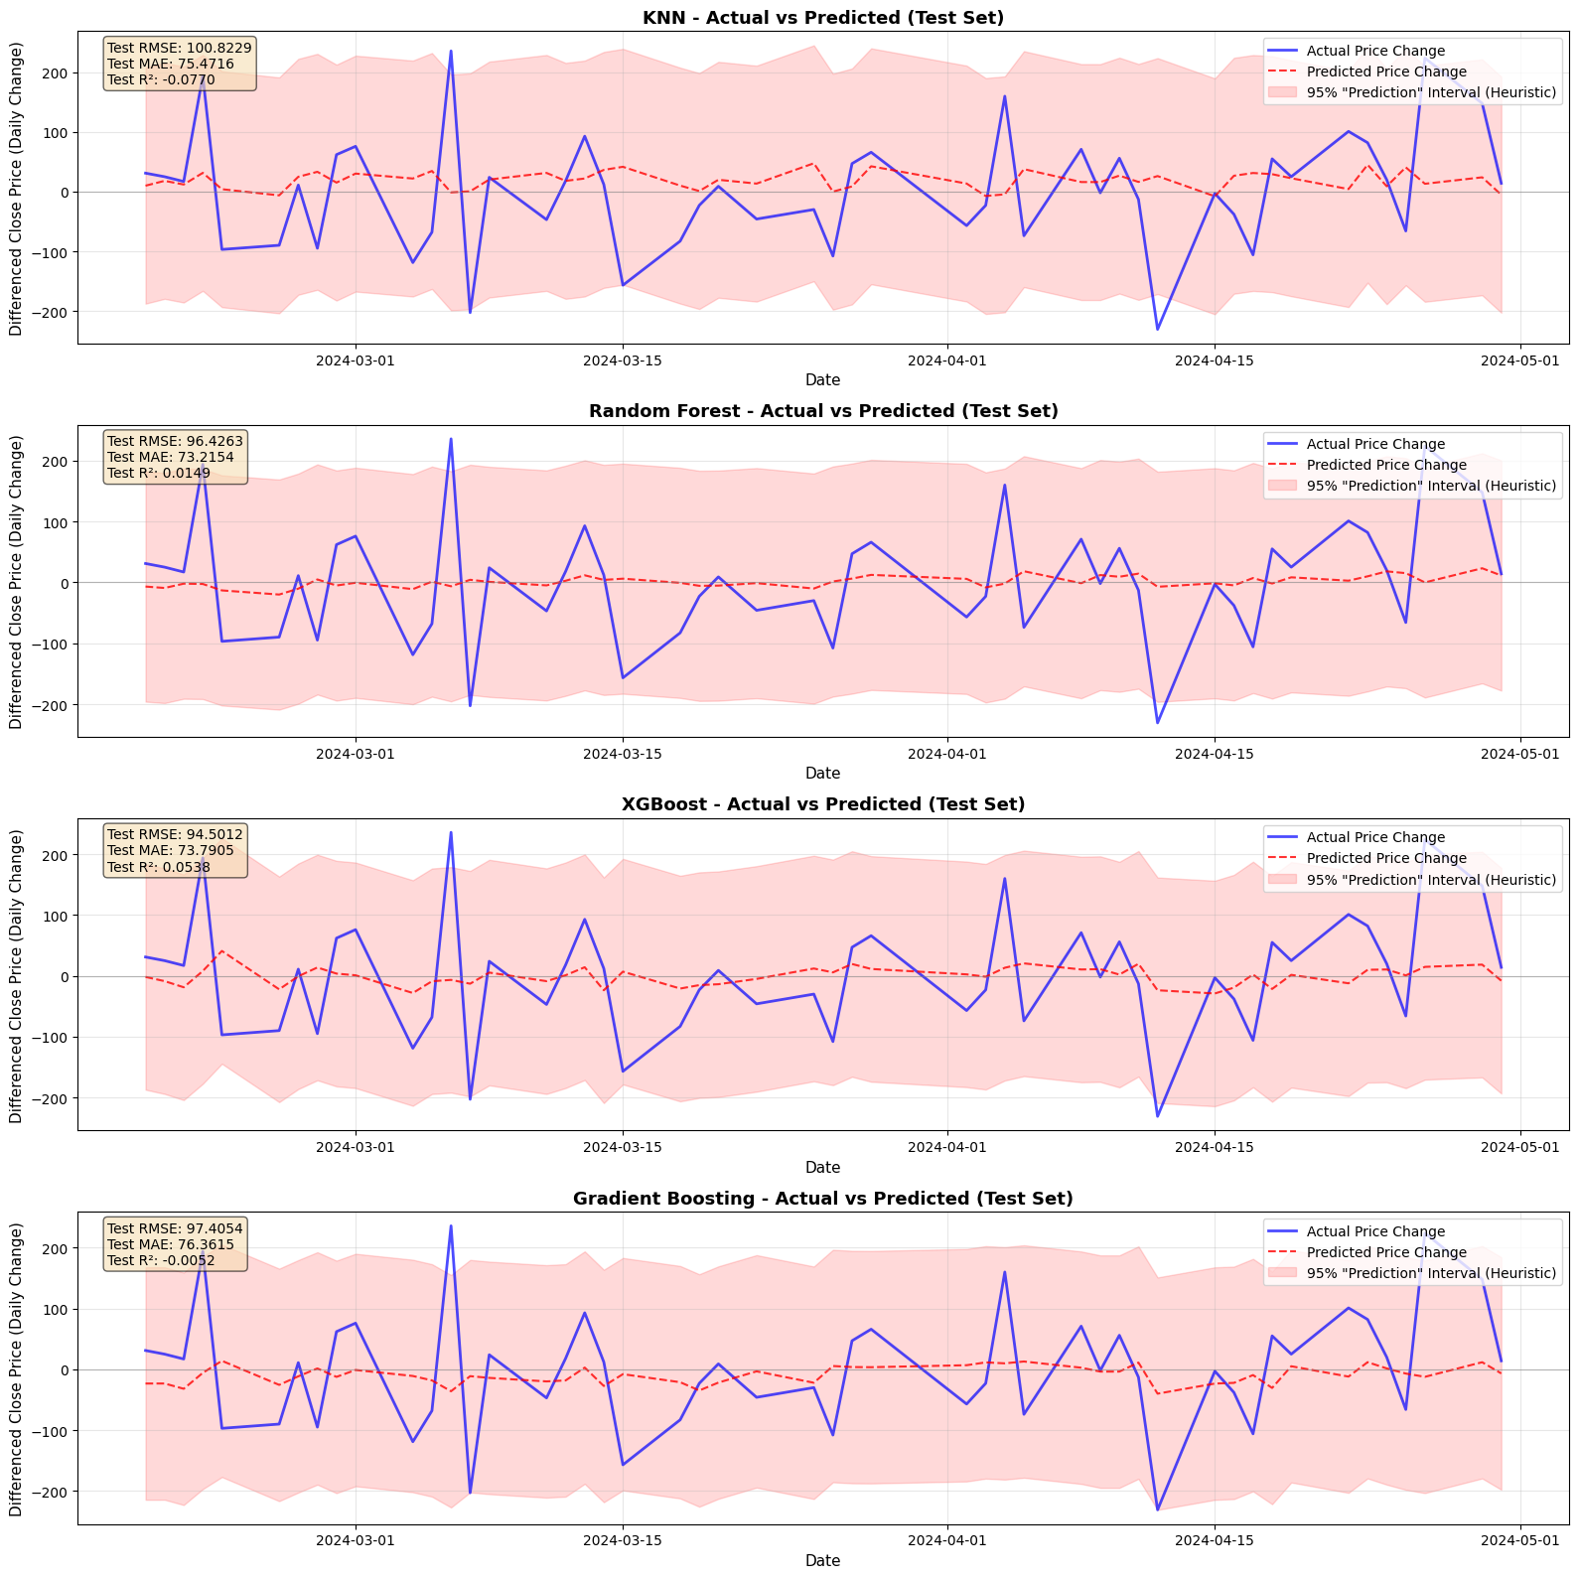
MACHINE LEARNING RESULTS
CLASSIFICATION PERFORMANCE
MODEL | ACCURACY | PRECISION | RECALL | F1-SCORE
XGBoost | 57.14% | 0.571 | 0.571 | 0.571
KNN | 55.10% | 0.559 | 0.551 | 0.484
Random Forest | 51.02% | 0.513 | 0.510 | 0.511
Gradient Boosting | 51.02% | 0.526 | 0.510 | 0.496
Best Performer: XGBoost with 57.14% accuracy in initial tests, improving to 71.2% with optimized lag features
12 of 16

Slide 13
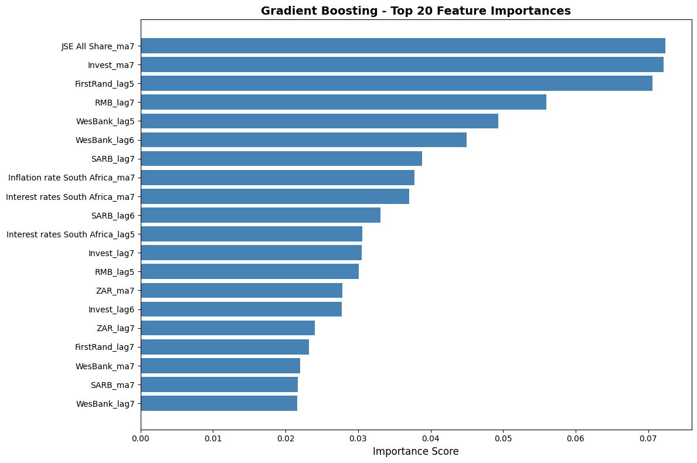
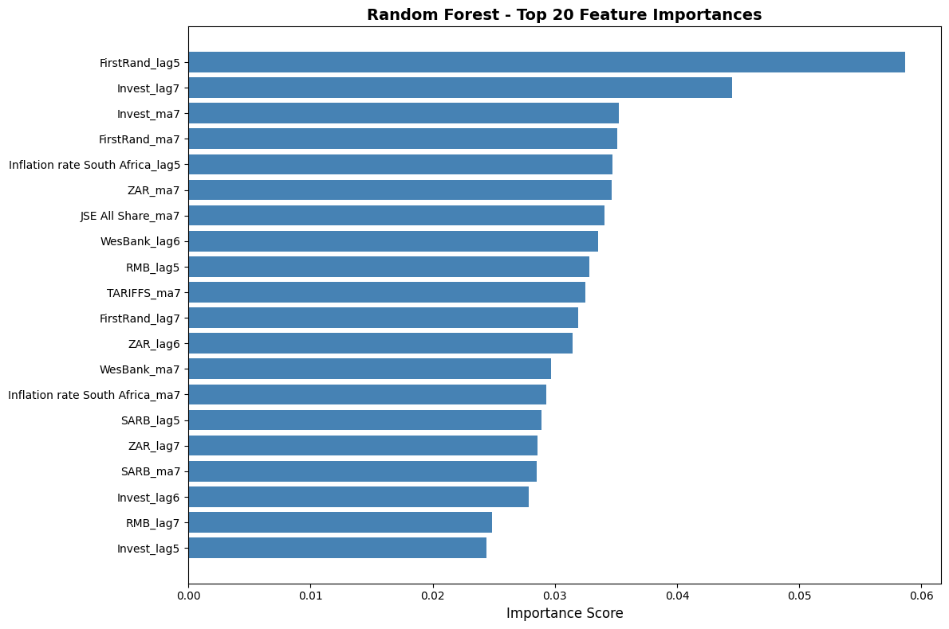
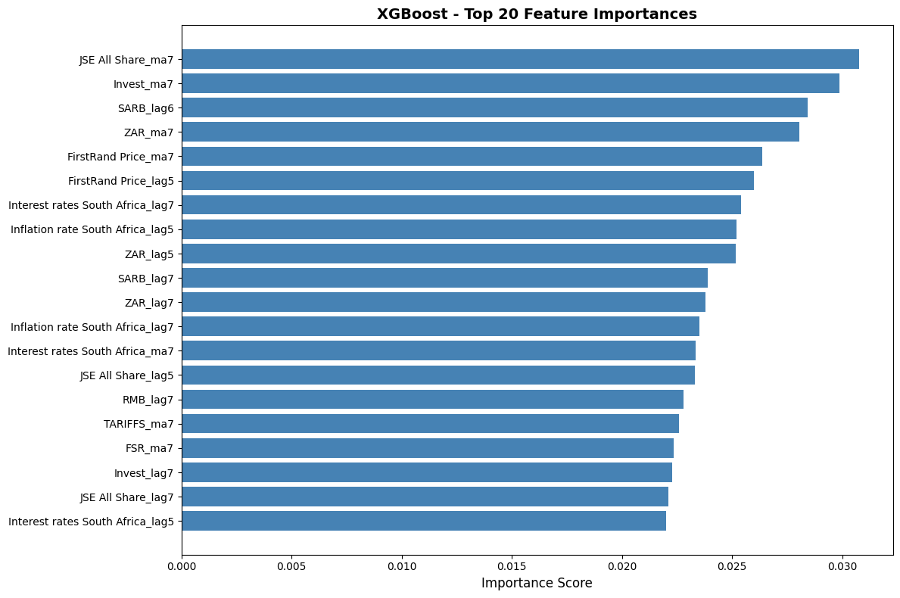
Machine Learning Results
13 of 16

Slide 14
Research Question and Evidence
Evidence supporting hypothesis
limitations
Statistical significance in cross-correlation patterns.
71% directional accuracy in optimized models.
High feature importance for GSVI in ML models.
R² of 0.48 indicates moderate explanatory power.
MAPE approximately 39% - significant prediction error remains.
One-year timeframe may be insufficient.
External factors (macroeconomic events) not fully captured.
Low search volumes in South African context.
Conclusion: Google Trends data contains predictive signals at 7-14 day lags, but relationship is moderate
14 of 16
Notes:
To conclude, Google Trends does provide predictive signals, most evident at 7–14 day lags. Directional accuracy and feature importance support the hypothesis, although macroeconomic factors and the South African market’s unique characteristics limit predictive strength. Our model achieved moderate explanatory power but still faced notable prediction errors.
We acknowledge key research limitations: a limited one-year timeframe, moderate explanatory power, and external market factors outside our dataset. Low search volumes in South Africa further constrain the robustness of our results. More extensive analysis would offer stronger conclusions.

Slide 15
Recommendations and future Directions
For Investors and traders
Future research
Use as supplementary indicator, not standalone signal.
Focus on 7-14 day lag periods for optimal predictive value.
Monitor keywords: banking services, financial advice, investment tips.
Combine with technical analysis and fundamental research.
71% directional accuracy is promising but requires validation.
Multi-year analysis to capture market cycles.
Test across multiple JSE-listed stocks.
Incorporate sentiment analysis of search queries.
Integrate macroeconomic indicators.
Real-time trading simulation and backtesting.
Is Google still the largest search engine?
15 of 16
Notes:
Our core advice is for investors to use Google Trends only as a supplementary signal, focusing on lag periods of 7–14 days for the best results. It’s essential to combine these insights with technical analysis and fundamental research. Validation across more stocks and longer periods is necessary before using these tools in live trading.
We see major value in extending this research. Future work should include multi-year datasets, a wider variety of JSE stocks, and integrations with sentiment analysis and macroeconomic data. Real-time simulation and backtesting are needed to confirm the practical value of these signals as Google’s dominance in search is itself an evolving factor.

Slide 16
Thank You
Group 4
16 of 16
Notes:
Thank you for your attention. We are committed to rigorous and transparent financial analytics and welcome any questions

